Slide 1

Welcome to learning about
Parts of Speech
This lesson will discuss
verbs

Slide 2


Slide 3


Slide 4


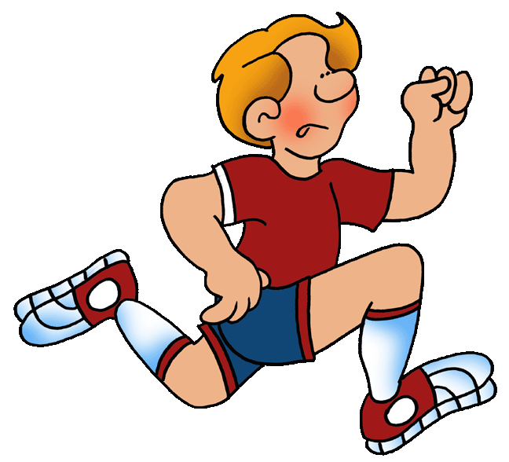



Slide 5
run
sleep
laugh
ride
climb

